Slide 1

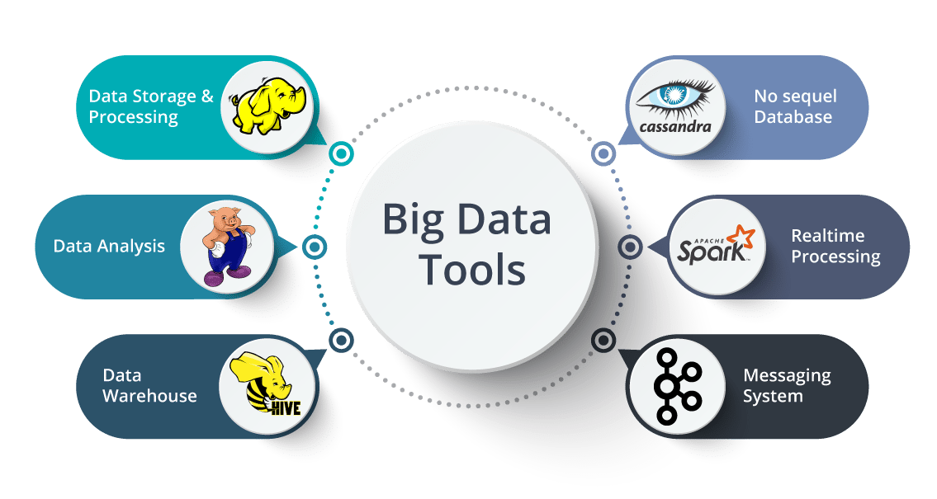
Big Data Storage and Processing MSc in Data Analytics CCT College Dublin
MapReduce Design Patterns
Week 3
Lecturer: Dr. Muhammad Iqbal*
Email: miqbal@cct.ie

Slide 2
Agenda
Concept of Design Patterns
MapReduce Programming Model
MapReduce Design Patterns for Big Data Processing
Summarisation Patterns
Filtering: Top Ten Pattern
Examples for MapReduce using purchases.txt dataset

Slide 3
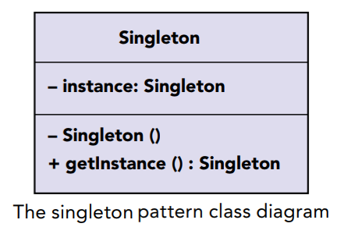
Design Patterns
Design patterns are “descriptions of communicating objects and classes that are customized to solve a general design problem in a particular context.”
Gang of Four
Design patterns offer solutions to common application design problems.
They provide generalized solutions in the form of boilerplates that can be applied to real‐life problems.
We can visualize design patterns using a class diagram, showing the behaviours and relations between classes.

Slide 4
Design Patterns
How Patterns Were Discovered and Why We Need Them?
Object‐oriented programming emerged in the 1980s, and several languages that built on this new idea shortly followed. For example, Smalltalk, C++, and Objective C are still prevalent today.
Design patterns have solved many issues that software engineers have with procedural programming languages like C and COBOL.
Developers found common problems during the software development and then the best solution is to develop some pattern to solve similar kind of problems.
When object‐oriented programming emerged, it was still a pre‐Internet world, and it was hard to share experiences with the masses.

Slide 5
MapReduce Design Pattern
MapReduce is a computing paradigm for processing data specifically that resides on hundreds of computers, which has been popularized recently by Google, Hadoop, and many others.
The paradigm is extraordinarily powerful, but it does not provide a general solution to what many are calling “big data”.
What is a MapReduce design pattern?
It is a template for solving a common and general data manipulation problem with MapReduce.
MapReduce is also called as a programming model that enables large volumes of data to be processed and generated by dividing work into independent tasks and executing the tasks in parallel across a cluster of machines.

Slide 6
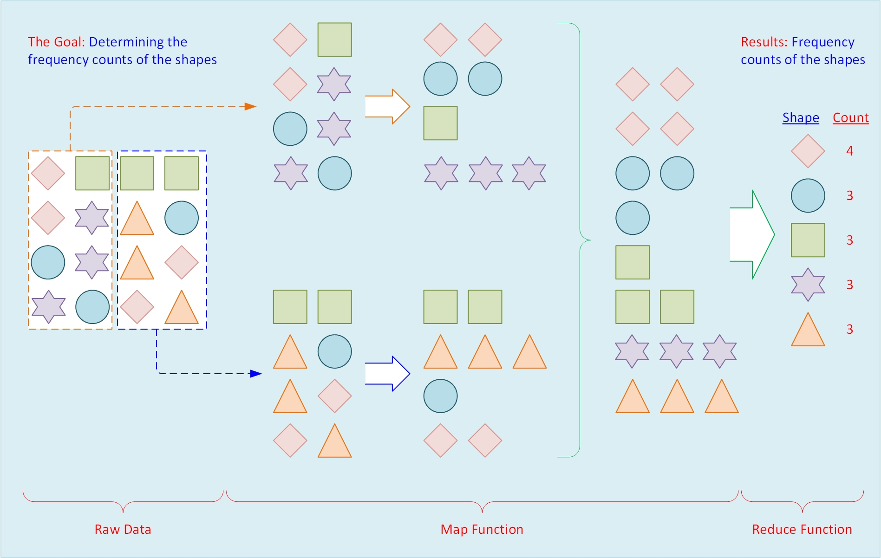
MapReduce Design Pattern

Slide 7
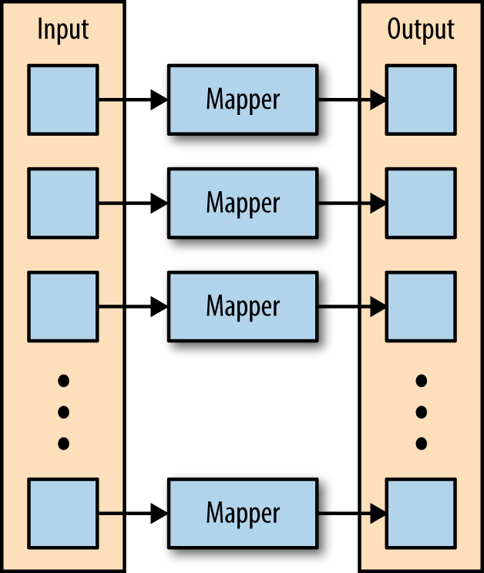
MapReduce with Python Data Flow
The MapReduce framework is composed of three major phases: map, shuffle and sort, and reduce. We describe each phase in detail.
Map
The first phase of a MapReduce application is the map phase. Within the map phase, a function (called the mapper) processes a series of key-value pairs (<k, v>).
The mapper sequentially processes each key-value pair individually, producing zero or more output key-value pairs.

Slide 8
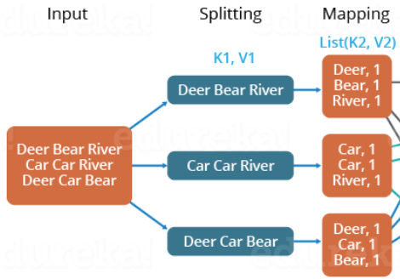
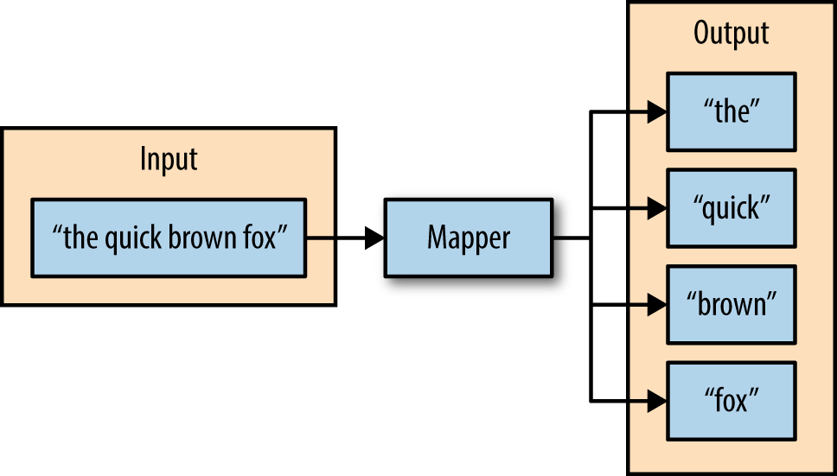
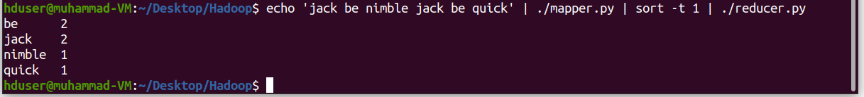
MapReduce with Python Data Flow
Consider a mapper whose purpose is to transform sentences into words as an example.
The input to this mapper would be strings that contain sentences, and the mapper’s function would be to split the sentences into words and output the words.
The input of the mapper is a string, and the function of the mapper is to split the input on spaces.
The resulting output is the individual words from the mapper’s input.

Slide 9
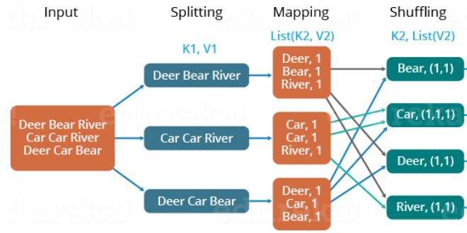
Shuffle and Sort
The second phase of MapReduce is the shuffle and sort.
As the mappers begin completing, the intermediate outputs from the map phase are moved to the reducers. This process of moving output from the mappers to the reducers is known as shuffling.
Shuffling is handled by a partition function, known as the partitioner.
The partitioner is given the mapper’s output key and the number of reducers, and returns the index of the intended reducer.
The final stage before the reducers start processing data is the sorting process. The intermediate keys and values for each partition are sorted by the Hadoop framework before being presented to the reducer.

Slide 10
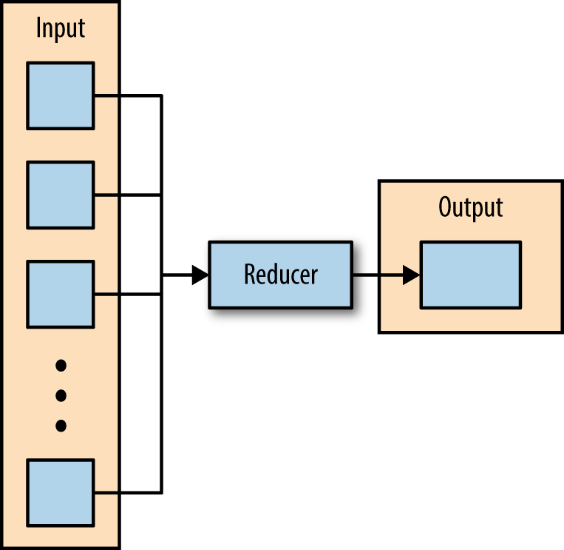
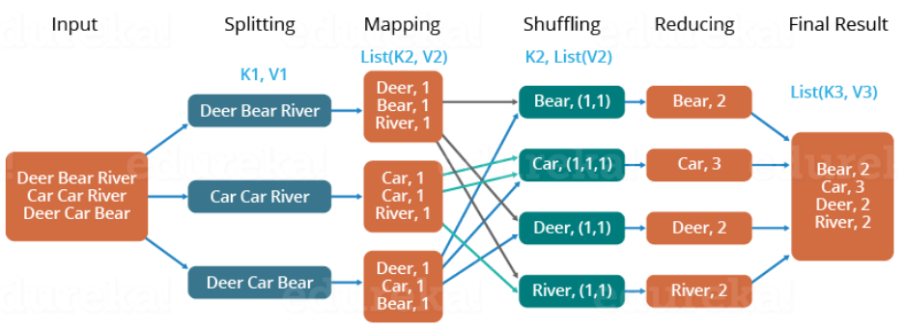
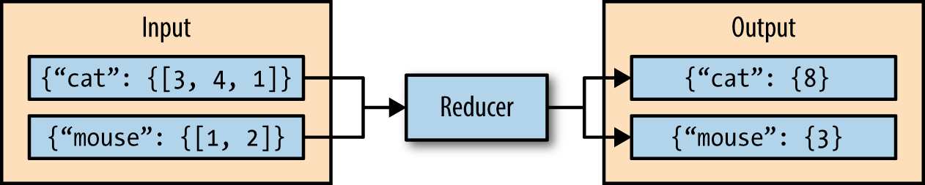
Reduce
The third phase of MapReduce is the reduce phase.
The reducer aggregates the values for each unique key and produces zero or more output key-value pairs.
Consider a reducer whose purpose is to sum all of the values for a key.
The input to this reducer is an iterator of all of the values for a key, and the reducer sums all of the values.
The reducer then outputs a key-value pair that contains the input key and the sum of the input key values.
The reducer iterates over the input values, producing an output key-value pair.
This reducer sums the values for the keys “cat” and “mouse”.

Slide 11
Hadoop Streaming
Hadoop streaming is a utility that comes packaged with the Hadoop distribution and allows MapReduce jobs to be created with any executable as the mapper and/or the reducer.
The Hadoop streaming utility enables Python, shell scripts, or any other language to be used as a mapper, reducer, or both.
How It Works
The mapper and reducer are both executables that read input, line by line, from the standard input (stdin), and write output to the standard output (stdout).
The Hadoop streaming utility creates a MapReduce job, submits the job to the cluster, and monitors its progress until it is complete.

Slide 12
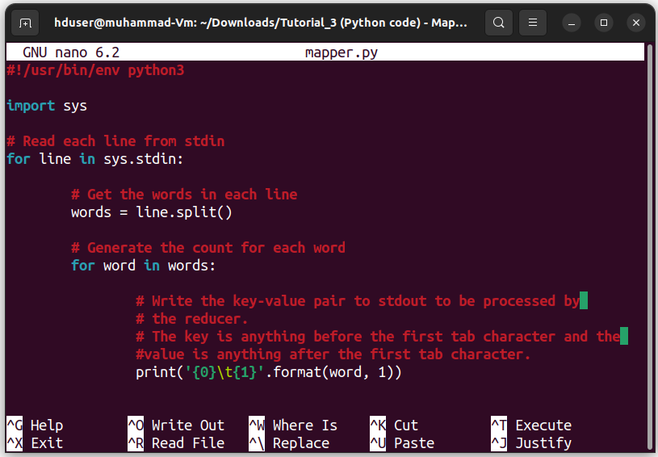
Hadoop Streaming A Python Example
To demonstrate how the Hadoop streaming utility can run Python as a MapReduce application on a Hadoop cluster, the WordCount application can be implemented as two Python programs as mapper.py and reducer.py.
mapper.py is the Python program that implements the logic in the map phase of WordCount.
It reads data from stdin, splits the lines into words, and outputs each word with its intermediate count to stdout.
The code in Example 3-1 implements the logic in mapper.py.
Example 3-1. python/MapReduce/HadoopStreaming/mapper.py
Notes:
When the mapper is initialized, each map task launches the specified executable as a separate process.
The mapper reads the input file and presents each line to the executable via stdin. After the executable processes each line of input, the mapper collects the output from stdout and converts each line to a key-value pair. The key consists of the part of the line before the first tab character, and the value consists of the part of the line after the first tab character. If a line contains no tab character, the entire line is considered the key and the value is null.
When the reducer is initialized, each reduce task launches the specified executable as a separate process.
The reducer converts the input key-value pair to lines that are presented to the executable via stdin. The reducer collects the executables result from stdout and converts each line to a key-value pair. Similar to the mapper, the executable specifies key-value pairs by separating the key and value by a tab character.

Slide 13
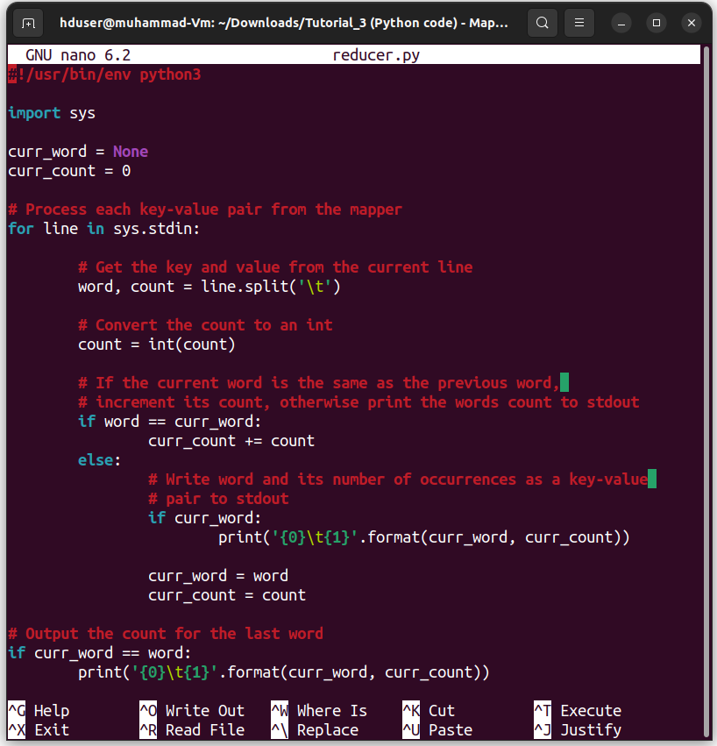
A Python Example
Example 3-2-python/MapReduce/HadoopStreaming/reducer.py
reducer.py is the Python program that implements the logic in the reduce phase of Wordcount.
It reads the results of mapper.py from stdin, sums the occurrences of each word, and writes the result to stdout.
The code in Example 3-2 implements the logic in reducer.py.
Before attempting to execute the code, ensure that the mapper.py and reducer.py files have execution permission.
The following command will enable this for both files as executables.
$chmod 700 mapper.py
$chmod 700 reducer.py

Slide 14
MapReduce Design Patterns
Categorization of Map-Reduce Patterns
Summarization
Filtering
Join
Data Organization
Input/ Output
Notes:
Summarization:
Example: Evaluate the total sales amount for each product category from a massive sales dataset.
Map Phase: Map each sales record to (product category, sales amount) key-value pairs in the map phase.
Reduce Phase: Add all the sales amounts for each product category to show the summary of the data.
Filtering:
Example: Fin the log entries from the dataset that has error messages from a log file.
Map Phase: Map each log entry to (log type, log entry) key-value pairs.
Reduce Phase: Select and produce those key-value pairs with "error" as the log type from the entire dataset.
Join:
Example: Using user IDs, combine user data with their purchasing history.
Map Phase: Map user records to (user ID, user information) key-value pairs and map purchase records to (user ID, purchase information) key-value pairs.
Reduce Phase: For each user ID, combine the user information with the associated purchase information.
Data Organization:
Example: To analyse trends, group tweets by hashtags.
Map Phase: Map each tweet to (hashtag, tweet) key-value pairs.
Reduce Phase: Collect and organize all tweets associated with a particular hashtag.
Input / Output:
Example: Process a significant number of text files to determine the frequency of a given word.
Input: Read text files as input data.
Map Phase: Map each word in the input files to (word, 1) key-value pairs.
Reduce Phase: Sum up the counts of each word to get the total occurrences.
Output: Write the word and its count to an output file.

Slide 15
MapReduce Design Patterns
Summarisation Patterns
Produce top-level and summarized view of data
Calculation of aggregate values
Total amounts
Average amounts
Min/ Max values
Specific Summarization Patterns
Numerical Summarisations
Inverted Index
Counting with Counters
Notes:
A forward index (or just index) is the list of documents, and which words appear in them. In the web search example, Google crawls the web, building the list of documents, figuring out which words appear in each page. The inverted index is the list of words, and the documents in which they appear.
In computer science, an inverted index (also referred to as a postings file or inverted file) is a database index storing a mapping from content, such as words or numbers, to its locations in a table, or in a document or a set of documents (named in contrast to a forward index, which maps from documents to content).
There are two main variants of inverted indexes: A record-level inverted index (or inverted file index or just inverted file) contains a list of references to documents for each word. A word-level inverted index (or full inverted index or inverted list) additionally contains the positions of each word within a document.
Let's say we have a collection of three documents:
Document 1: "The quick brown fox"
Document 2: "Jumped over the lazy dog"
Document 3: "The fox is quick and brown"
We want to create an inverted index for these documents. Here's how the inverted index might look:
Term | Documents
and | 3
brown | 1, 3
dog | 2
fox | 1, 3
is | 3
jumped | 2
lazy | 2
over | 2
quick | 1, 3
the | 1, 2, 3
In this example, each term is associated with a list of document identifiers where that term appears. For instance:
The term "fox" appears in documents 1 and 3.
The term "quick" appears in documents 1 and 3.
The term "dog" appears only in document 2.
With this inverted index, if a user searches for the term "brown," the system can quickly identify that it appears in documents 1 and 3 without needing to scan the entire text of each document. This makes information retrieval much more efficient.

Slide 16
MapReduce Design Patterns Numerical Summarisation
Pattern Description
The numerical summarisations pattern is a general pattern for calculating aggregate statistical values over your data.
It is extremely important to use the combiner properly and to understand the calculation you are performing.
Intent
Group records together by a key field and calculate a numerical aggregate per group to get a top-level view of the larger data set.
Examples for the numerical summarisation function include: minimum, maximum, average, median and standard deviation.
Motivation
It is difficult to get the real meaning of the data manually because of the large quantities of data.
For example, noticing real usage patterns by reading through terabytes of log files with a text reader.

Slide 17
Summarisation Patterns
Word count
The “Hello World” of MapReduce.
The application outputs each word of a document as the key and “1” as the value, thus grouping by words.
The reduce phase adds up the integers and outputs each unique word with the sum.
Record count
A very common analytic to get a heartbeat of your data flow rate on a particular interval (weekly, daily, hourly, etc.).

Slide 18
Summarisation Patterns
Min/ Max/ Count
An analytic to determine the minimum, maximum and count of a particular event.
Such as the first time a user posted, the last time a user posted, and the number of times they posted in between that time period.
You don’t have to collect all three of these aggregates at the same time, or any of the other use cases listed here if you are only interested in one of them.
Average/ Median/ Standard Deviation
Similar to Min/ Max/ Count, but not as straightforward of an implementation because these operations are not associative.
A combiner can be used for all three but requires a more complex approach than just reusing the reducer implementation.

Slide 19
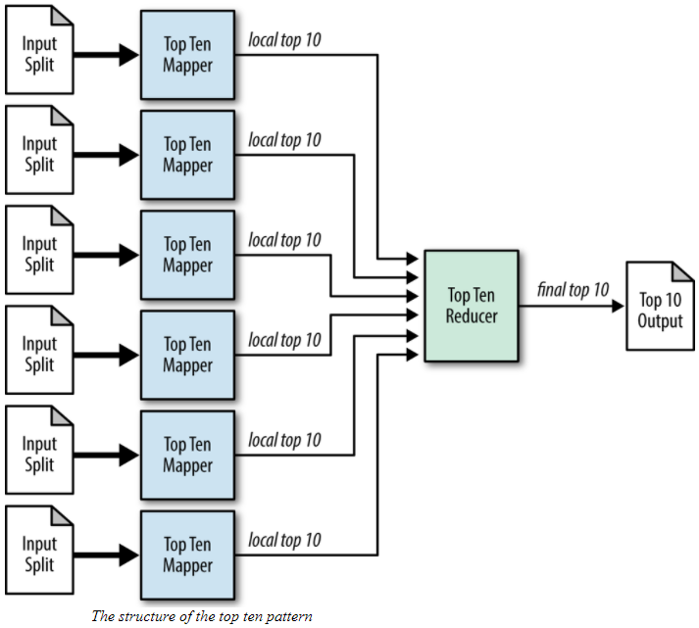
Filtering Design Pattern Top Ten
The top ten pattern is a bit different than previous ones in that you know how many records you want to get in the end, no matter what the input size. In generic filtering, however, the amount of output depends on the data.
Intent
Retrieve a relatively small number of top K records, according to a ranking scheme in your data set, no matter how large the data.
Motivation
Finding outliers is an important part of data analysis because these records are typically the most interesting and unique pieces of data in the set.
The point of this pattern is to find the best records for a specific criterion so that you can take a look at them and perhaps figure out what caused them to be so special.
Use Cases
Outlier analysis
Select interesting data
Catchy dashboards

Slide 20
Resources/ References
Tom White, 2012, Hadoop The Definitive Guide, O’Reilly Publishing
Hadoop with Python, Zach Radtka; Donald Miner, O'Reilly Media, Inc., 2015.
Lublinsky B., Smith K. T. and Yakubovich A 2013, Professional Hadoop Solutions, Wrox [ISBN: 13:978-11186]
Holmes A 2012, Hadoop in Practice, Manning Publications [ISBN: 13:978-16172]
McKinney W. 2012, Python for Data Analysis, O'Reilly Media [ISBN: 13: 978-14493]
https://hadoop.apache.org/docs/stable/hadoop-mapreduce-client/hadoop-mapreduce-client-core/MapReduceTutorial.html
Some images are used from Google search repository (https://www.google.ie/search) to enhance the level of learning.
Copyright Notice The following material has been communicated to you by or on behalf of CCT College Dublin in accordance with the Copyright and Related Rights Act 2000 (the Act). The material may be subject to copyright under the Act and any further reproduction, communication or distribution of this material must be in accordance with the Act. Do not remove this notice

